Slide 1
Internship Mid-Term Presentation
- Swarali Paygude (TY Btech CSE)
Anushka Dalvi (TY Btech CSE)

Slide 2
Project Title
Extraction and analysis of data related to hiring process in HR-Tech area

Slide 3
Internship Project Objective
To implement and test modules for data models
Feature extraction and predictive analysis of data related to hiring process in HR-Tech area

Slide 4
Key Learnings
Java basics (syntax and programming basics)
Object Oriented Programming in Java
Using Eclipse for Java programming
Encapsulation using packages and classes
JDBC using Maven project

Slide 5
Key Learnings
Maven dependencies
New concepts like Hashmaps, Arraylists, JSON Objects
DBVisualizer to access database
AWS lambda project
AWS Lambda for deploying API
Postman to test output using API endpoint

Slide 6
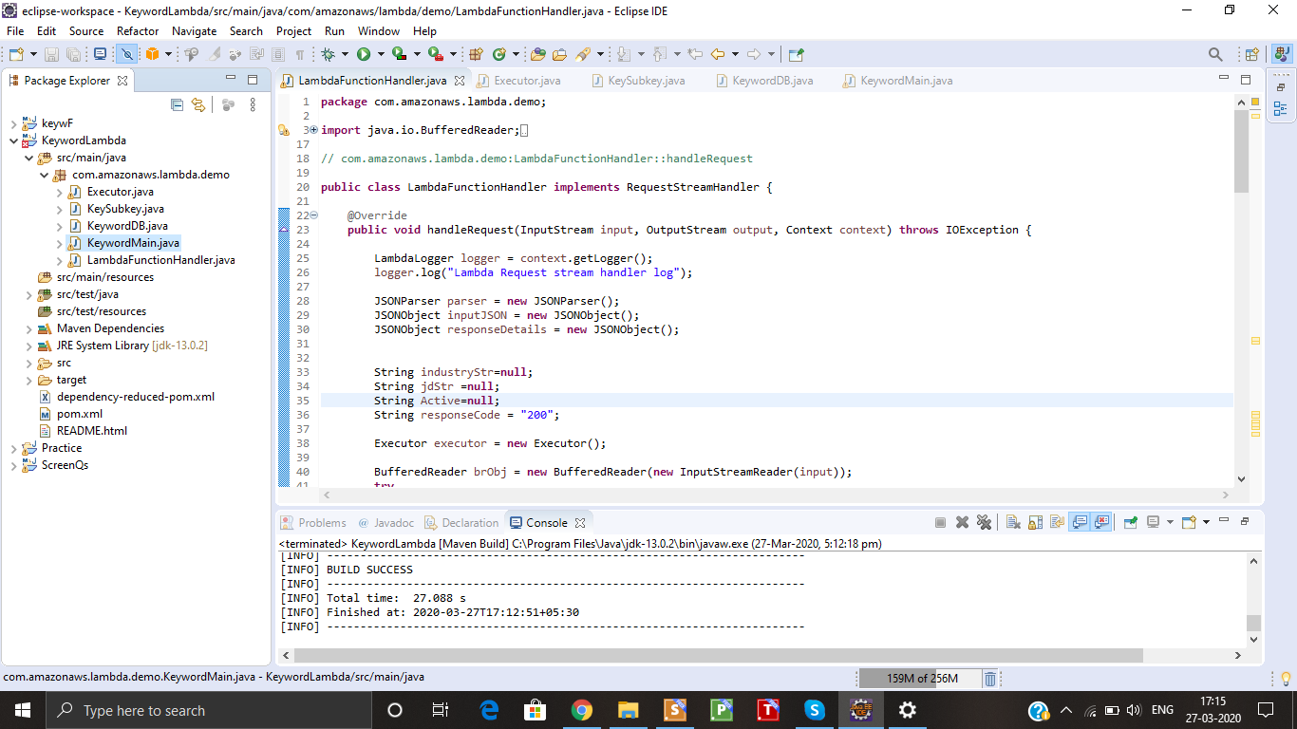

Slide 7
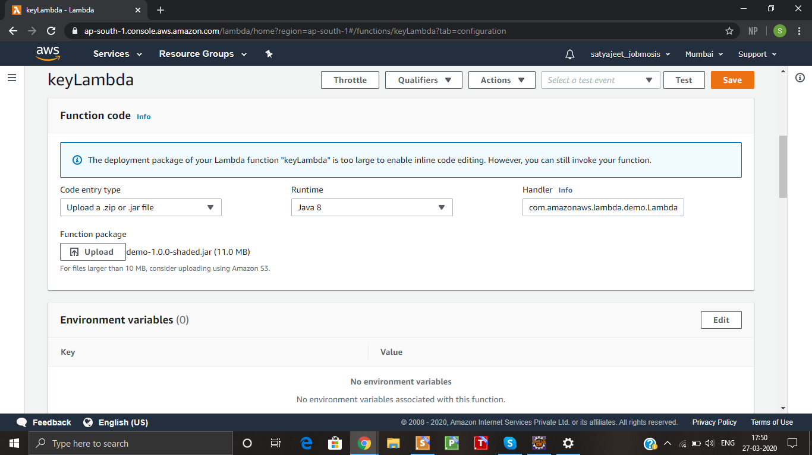
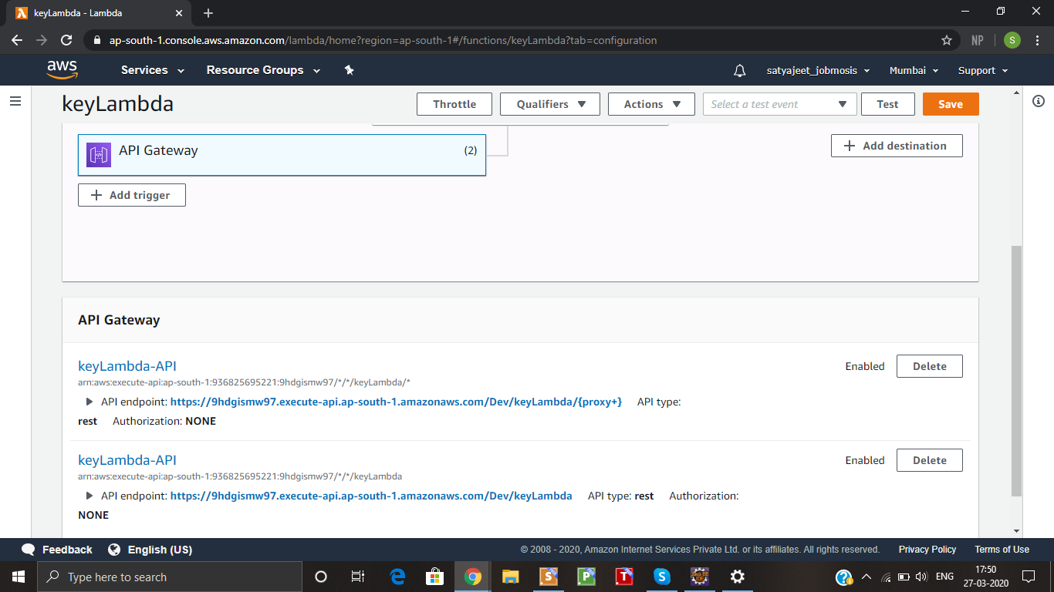

Slide 8
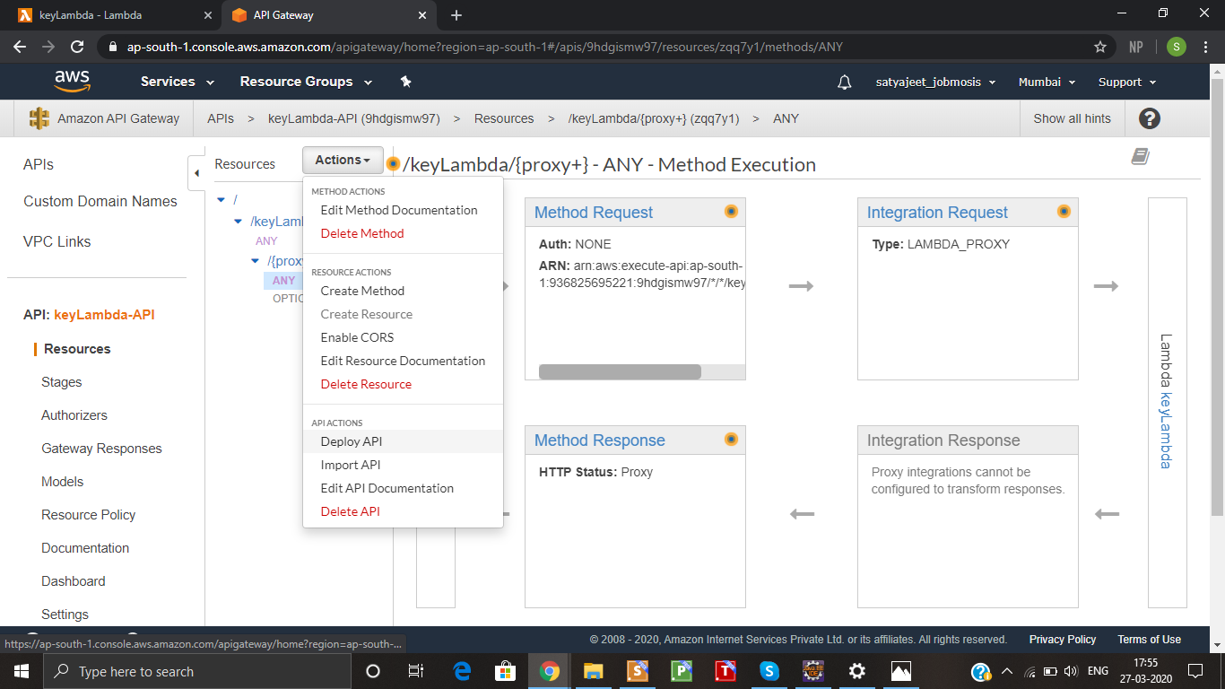
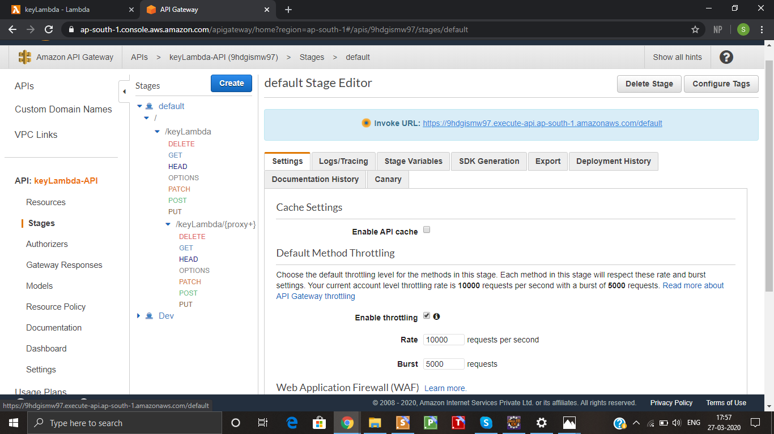

Slide 9
Tasks completed till date
Java video tutorials from Lynda.com
Maven project for basic keyword extractor (to detect keywords and their count from given JD as input)
JDBC for list of keywords from database
AWS lambda project - lambda function handler, executor - for keyword extractor
API deployment on AWS Lambda to create API

